Slide 1
Plant Growth Simulation using CUDA
‘Self-organizing Tree models for Image Synthesis’ by Palubicky el. al., 09’ SIGGRAPH
Tony Zhang
TECH 621

Slide 2
Agenda
Plant Growth Model
GPU Acceleration
Demo Show
Future Work

Slide 3
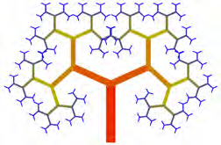
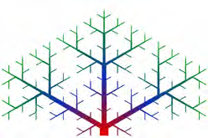
Plant Growth Model
Previous Work
Fractal Tree with Recursion
Self Organizing Development
Pictures from ‘Palubicky 09 SIGGRAPH’

Slide 4
Plant Growth Model
Necessary Factors for Plant Growth
1. Environmental Input
a) Space Colonization
b) Shadow Propagation
2. Bud Fate Calculation – Borchert Honda Model 3. Addition of new shoots 4. Branch Diameter Calculation

Slide 5
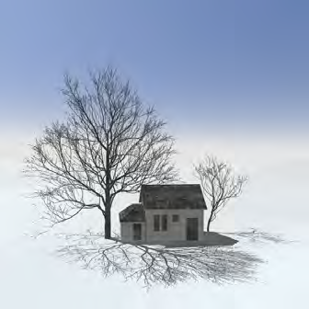
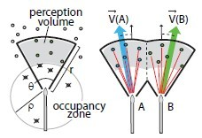
Plant Growth Model
Environmental Input - Space Colonization
Pictures from ‘Palubicky 09 SIGGRAPH’

Slide 6
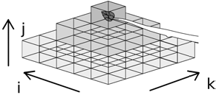
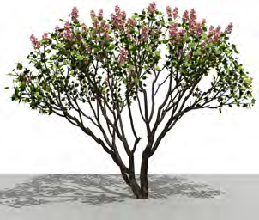
Plant Growth Model
Environmental Input - Shadow Propagation
(I, J, k) = (I ±p, J - q; K ±p)
Pictures from ‘Palubicky 09 SIGGRAPH’

Slide 7


Plant Growth Model
Buds Fate Calculation – Apical Control
Pictures from ‘Palubicky 09 SIGGRAPH’

Slide 8
Plant Growth Model
Addition of new shoots
v(internode) = k1 * v(optimized) + k2 * v(gravity) + k3 * v(light)
Branch Diameter Calculation
n usually is between 2 and 3
Pictures from ‘Palubicky 09 SIGGRAPH’

Slide 9
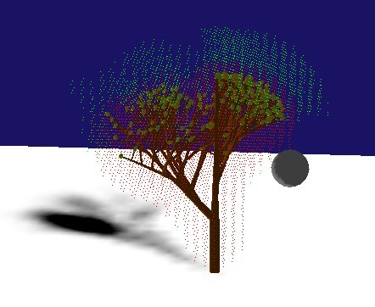
GPU Acceleration
Space Colonization
__device__ struct Cell *_mat;
For each Voxel (Gathering): 1. Occupied ? 2. In perception volume ?

Slide 10
GPU Acceleration
Shadow Propagation
__device__ struct Cell *_mat;
For each voxel (Gathering):
If within the shadow area of some object:
Update the shadow values of the corresponding cell

Slide 11
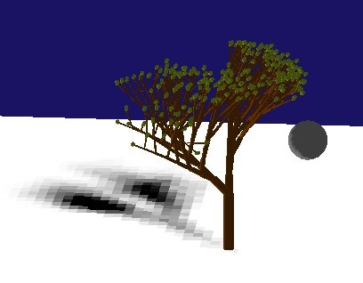
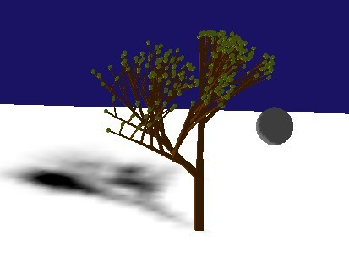
GPU Acceleration
Ray-Casting Ground Shadow and its Bi-Linear Smooth

Slide 12
Demo Show
Resolution : 80 * 80 * 80
Simplified Object Representation
Simplified BH-model
Speeding Up
64 buds: 47 times faster
128 buds: 12 times faster
256 buds: 10 times faster

Slide 13
Future Work
Increasing resolution, as 1024 * 1024 * 1024
Implementing a relative complete BH model
Internodes connection smooth using cones
Texture (for Internodes, Ground, etc.)

Slide 14
Plant Growth Simulation using CUDA
‘Self-organizing Tree models for Image Synthesis’ by Palubicky el. al., 09’ SIGGRAPH
Tony Zhang
TECH 621

